Slide 1

ENMT 4730 SLAM Implementation
Eric Borcherding

Slide 2

Artificial Intelligence (AI)

Slide 3
Problem Statement
Objectives
Required Hardware
Design
Sensors
Navigation

Slide 4
Problem Statement
Apply localization, mapping, and path planning techniques discussed in 4730 Advance Ground Robotics class.
Utilize a wirelessly controlled ground robot, vision system and python programming language.

Slide 5
Objectives
Localize ground robot in environment utilizing computer vision
Track ground robot as it moves around an ‘obstacle’ course.
Generate a map of navigable terrain while the robot moves
Path plan to generate return path to starting position

Slide 6

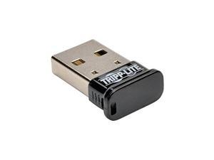
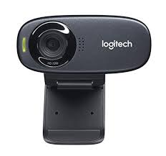



Equipment List
Hardware:
Robot: Sphero
Vision System: 720P webcam
Communication: Bluetooth Dongle
Software:
Language: Python
Vision Toolkit: OpenCV
Analysis Toolkit: Scikit Learn

Slide 7
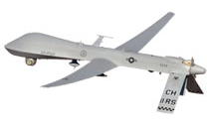
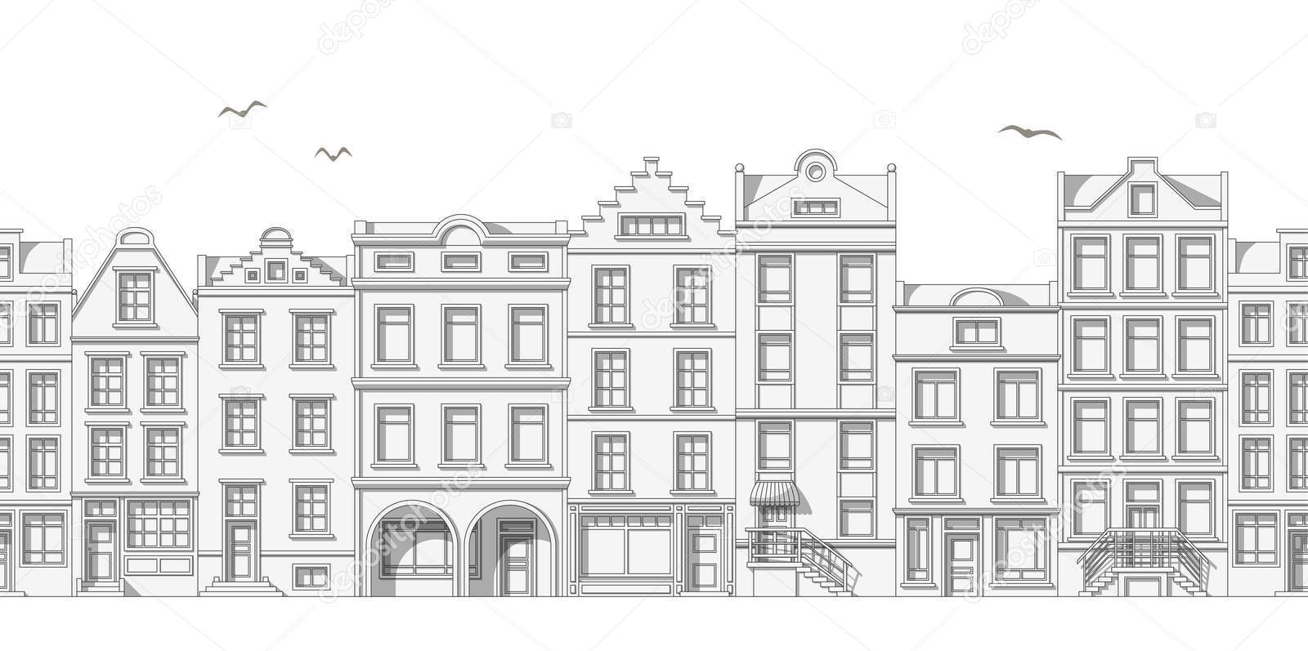

Concept
Low cost ground robot
High value overhead processing planning drone

Slide 8
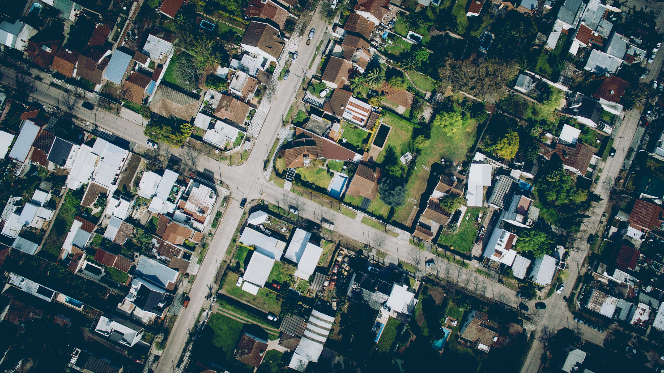



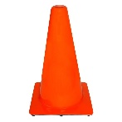
Concept

Slide 9



Robot Design
Sphero:
Holonomic robot
Manipulates internal mass to steer, accelerate and decelerate
Independent motors used to move mass in sphere
Motors drive same direction: Mass is raised allowing sphero to rotate forwards

Slide 10

Robot Design
Sphero:
Holonomic robot, capable of turning in place
Manipulates internal mass to steer, accelerate and decellerate
Independent motors used to move mass in sphere
Motors drive same direction: Mass is raised allowing Sphero to rotate forwards
Sphero stops by returning mass to position of lowest potential energy
Motors counter rotate: Mass rotates inside shell, causing Sphero to change direction of rotation

Slide 11
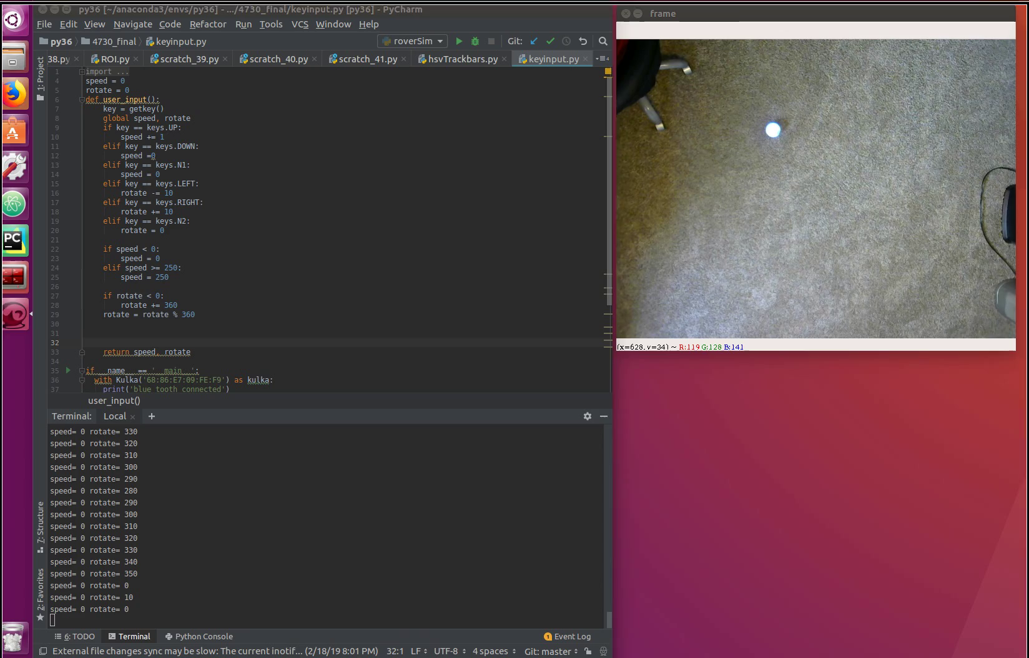
Robot Design

Slide 12
Localization
Two Stage Localization:
HSV (Hue, Saturation, Value) Filter
HSV separates image intensity from color information
Commonly used in computer vision because of robustness to changing light conditions
Hough Circle Transform
Detects outer diameter of robot
Returns position of robot within reference frame
This position is used to initialize tracking algorithm

Slide 13
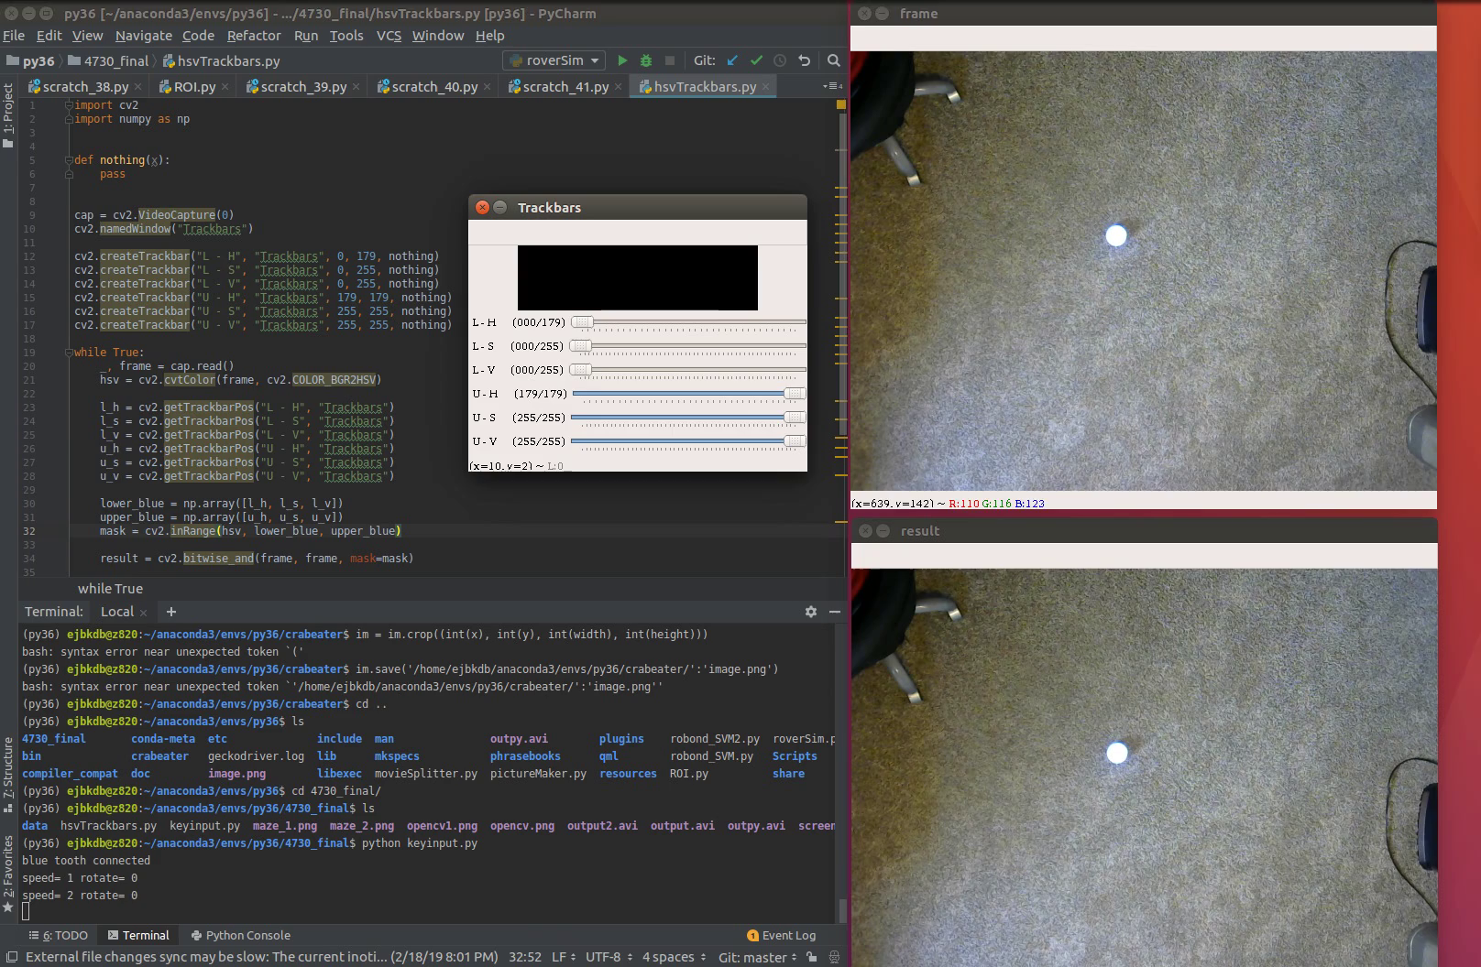
Localization - HSV Filter

Slide 14

Localization - Hough Transform

Slide 15
Tracking
BOOSTING Tracker
Identify area of interest (utilize Localization data)
Tracker generates reference image/features.
Scans video frames to identify reference image, updates location of object being tracked.
Utilizes data from previous frames to predict how wide an area it must search to identify object of interest
Determines based on probability where the object is in new field of interest

Slide 16
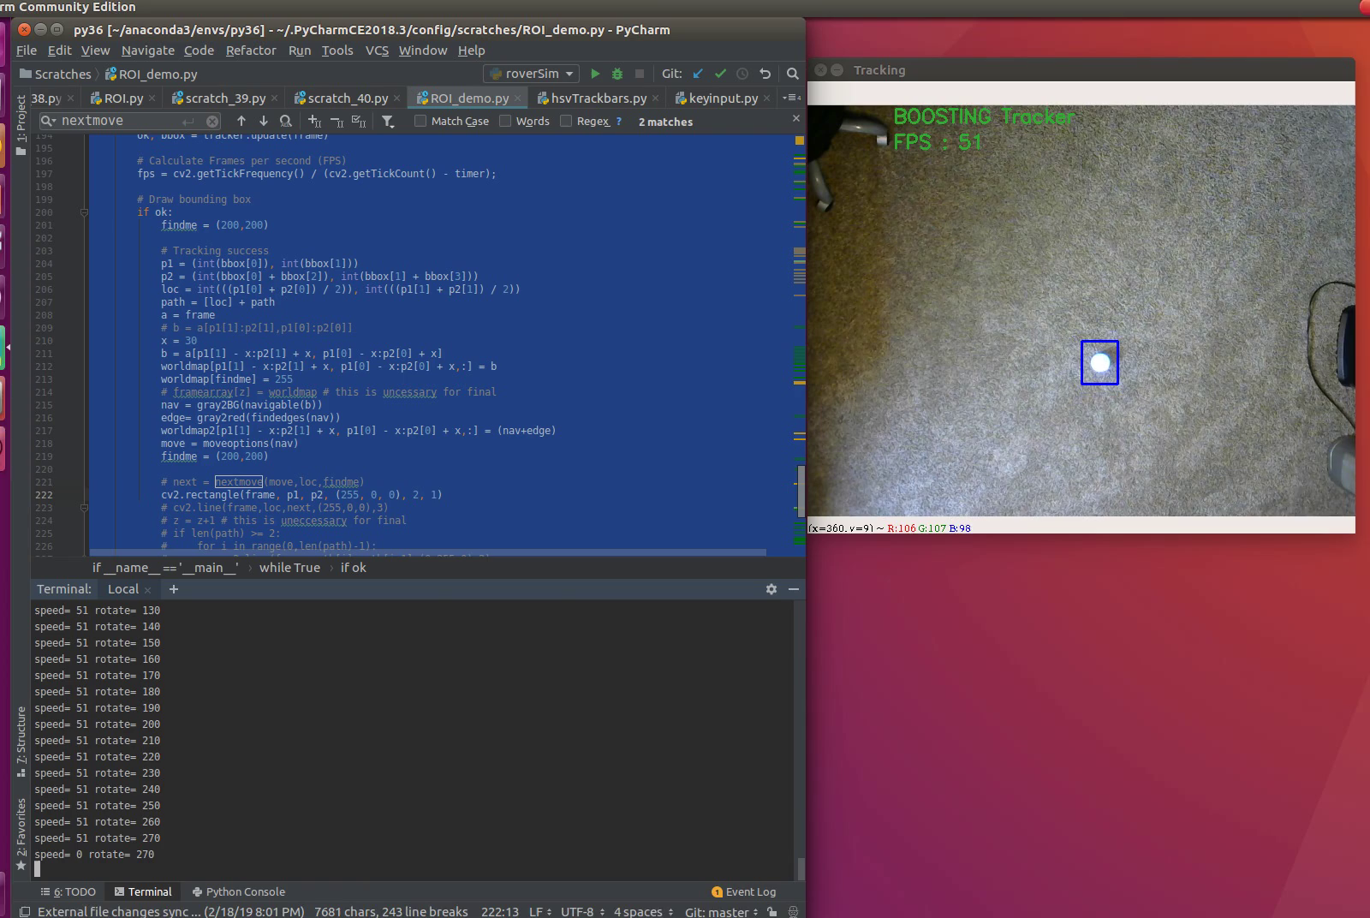
Tracking

Slide 17
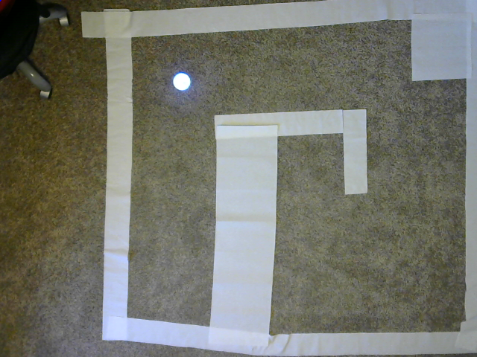
Mapping
Enviroment:
Developed a course for the Sphero to navigate through
Intent was to map course as it progressed

Slide 18
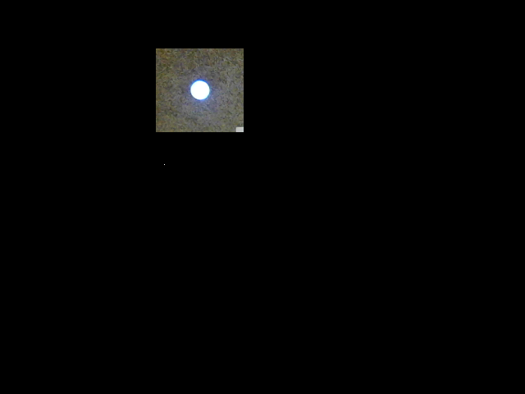

Mapping
Reduced Field of View:
Reduced viewable area to simulate drone following overhead
Implented HSV filter to determine navigable vs. non-navigable terrain
Full World View
Drone View
Navigable Map

Slide 19
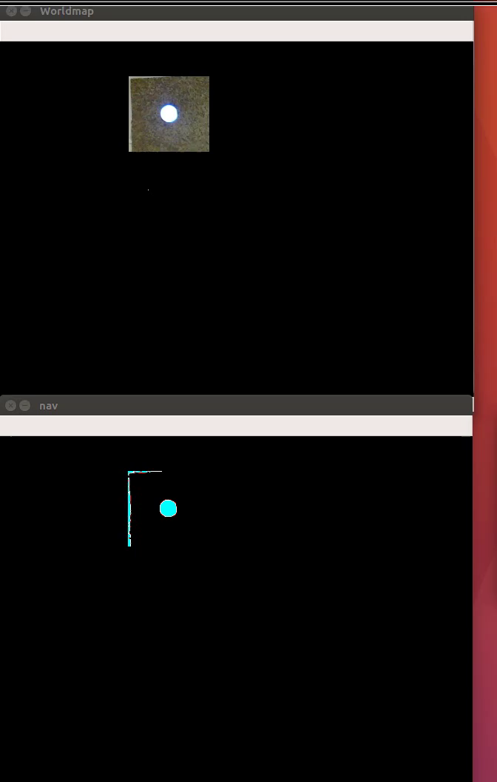
Mapping

Slide 20

Mapping

Slide 21
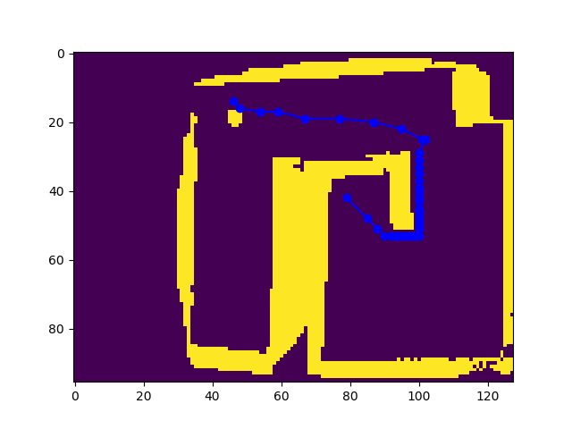

Path Finding
A* Path Planning
Heuristic based approach

Slide 22
Conclusion
Implemented and demonstrated several techniques used in Ground Robotics. Including:
Localization
Mapping
Path Planning

